Slide 1
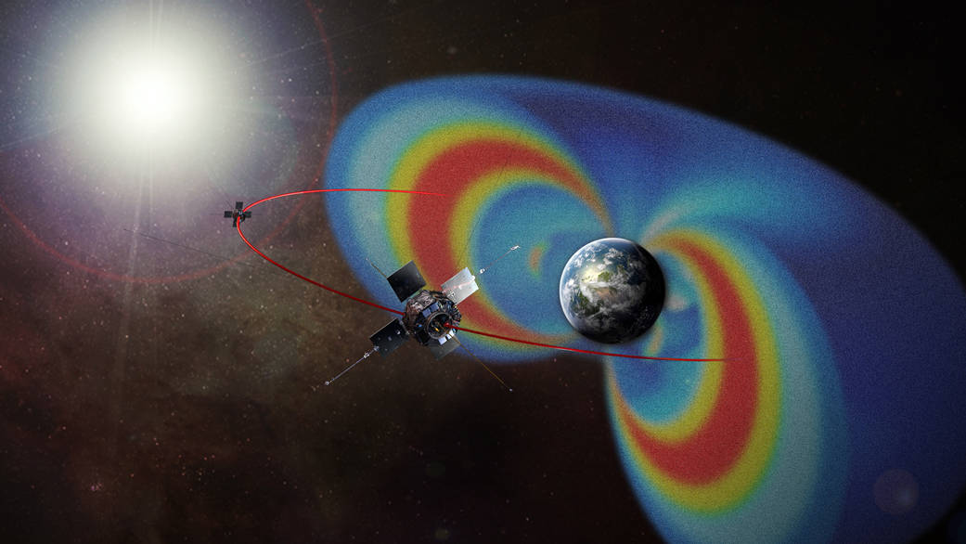
NASA
NASA Van Allen Probes (https://www.nasa.gov/mission_pages/rbsp/mission/index.html)
See references [3,4,5]

Slide 2
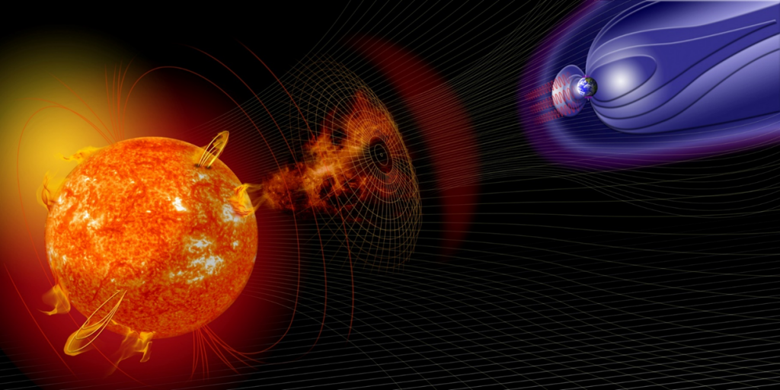
Outline
What is the magnetosphere?
What is space weather?
Earth’s dynamic radiation belts
Lots of information. Probably too much!
Don’t worry! ☺
NASA

Slide 3
Space is not a vacuum
Plasma >95% / 99% / 99.9% Universe ?
Space physics = plasma physics
NASA
Plasma physics in general [reference 1]
Earth’s magnetosphere https://www.swpc.noaa.gov/phenomena/earths-magnetosphere
Radiation belts [references 1, 3, 4]

Slide 4
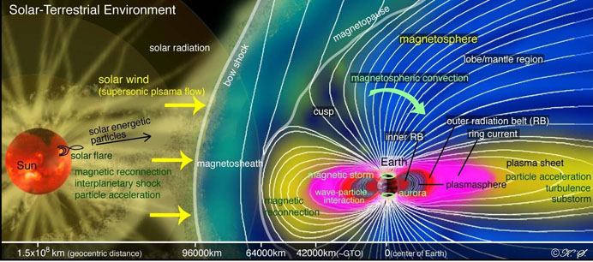
What is Space Weather?
JAXA/ISEE

Slide 5
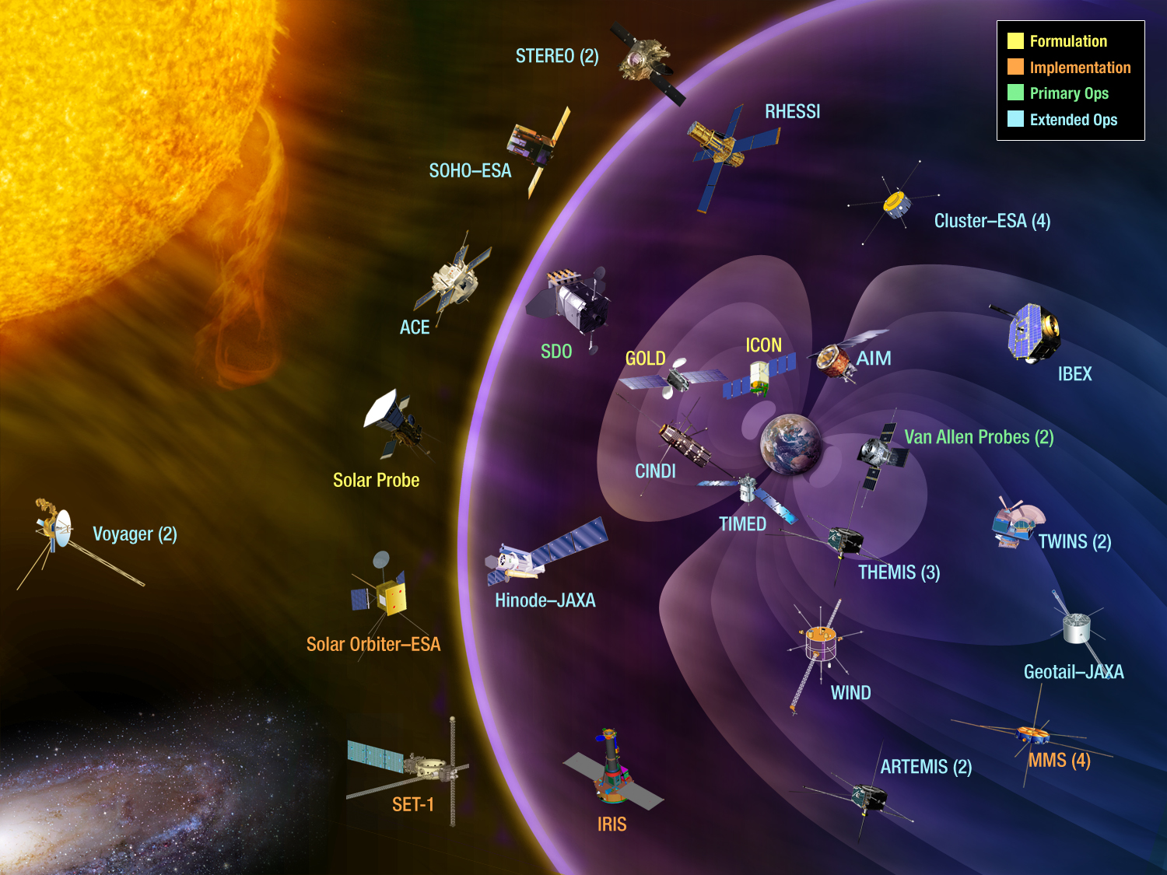
Some NASA Space Weather Missions (+ ESA + JAXA + …)
5/21
JAXA/ISEE
NASA

Slide 6
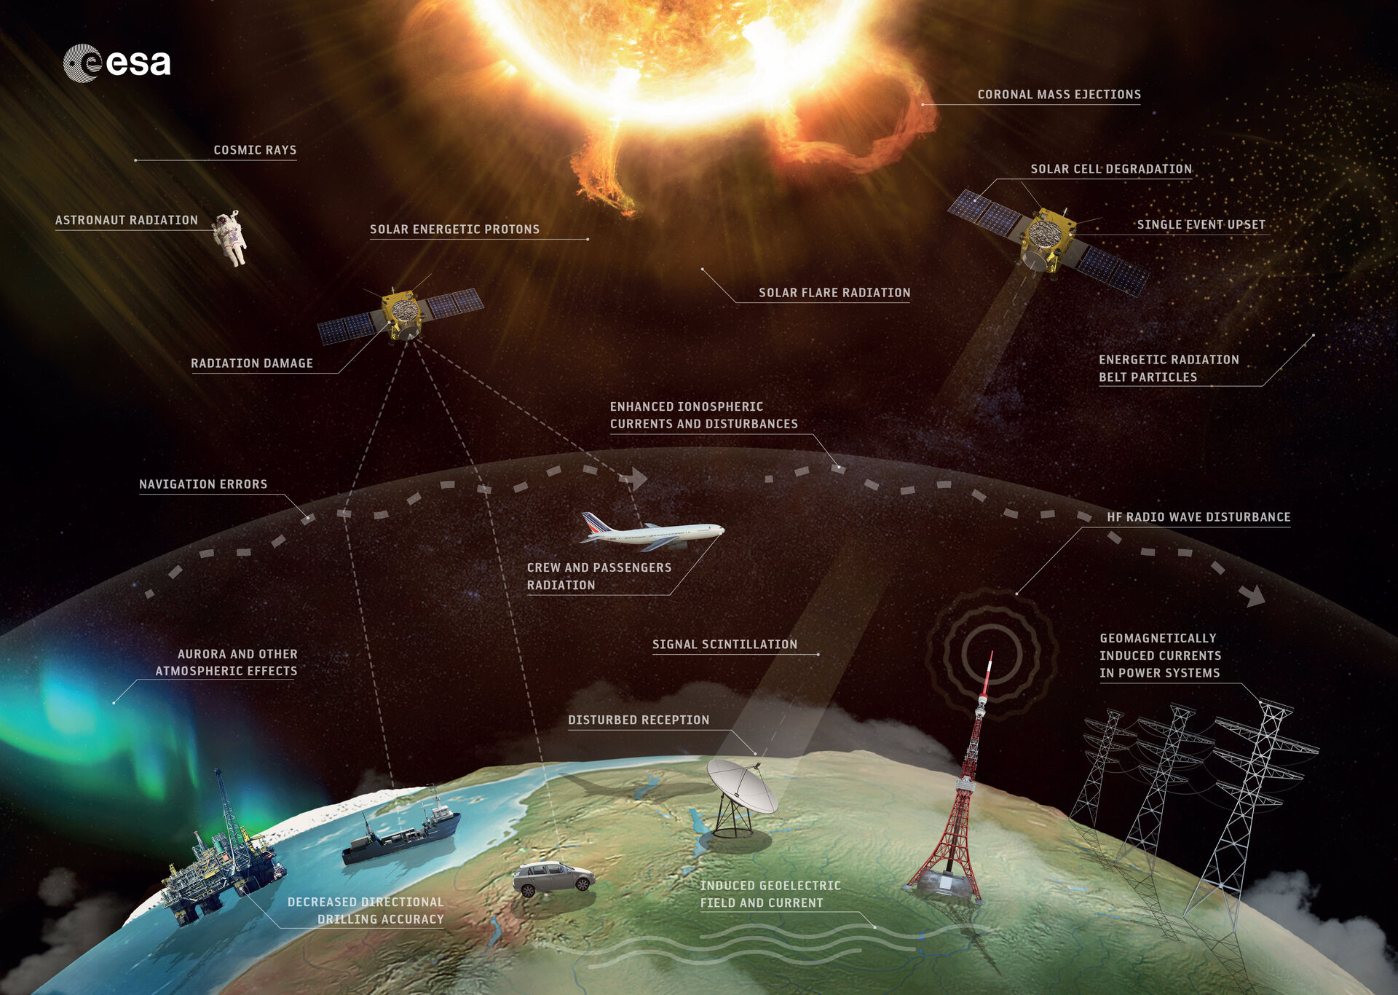
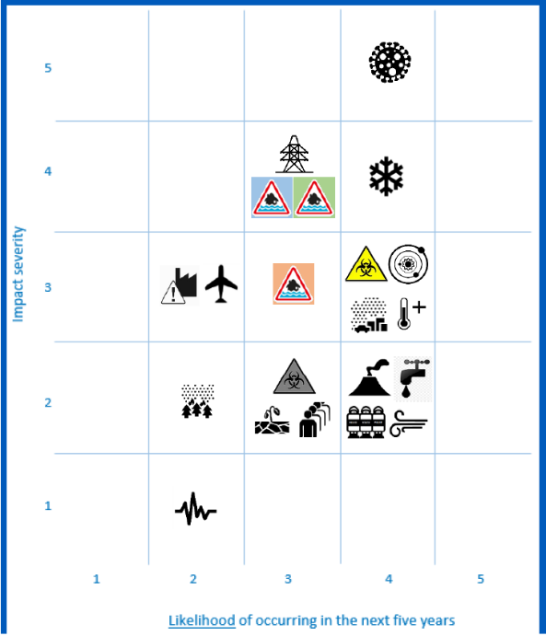
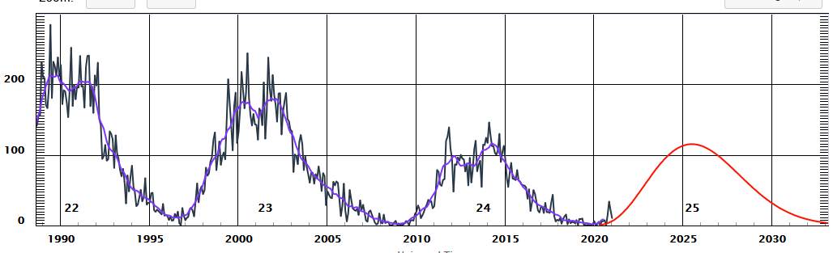
Space
Weather
Impacts
See references [2,7,8,9]
6/21
Cabinet Office National
Risk Register of Civil
Emergencies 2017(-2023)

Slide 7




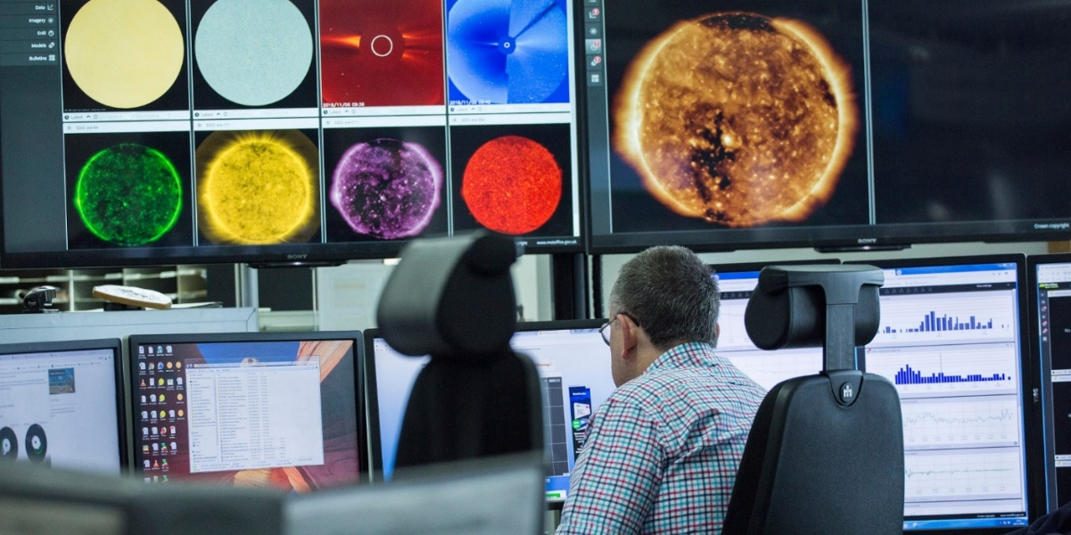
Operational modelling @ MET Office (MOSWOC)
7/21
MET Office

Slide 8

Use those references and others to try understand the following:
What is a plasma?
What is space weather?
What is the magnetosphere?
What is the plasmasphere?
What are the radiation belts?
Plasmasphere & Radiation belts
Space weather
NASA
SAMPEX

Slide 9
Recap
Project aims
Project plan
Note that
some references refer to that original list that I sent, e.g. “Reference 1” (show pdf)
I will also discuss some new references
You should also go and find your own references!
Any questions before we begin? ☺

Slide 10

Space is not a vacuum – it is filled with plasma.
Plasma is an ionized gas
Plasma >95% / 99% / 99.9% Universe ?
Space physics = plasma physics
Maxwell’s equations for electromagnetic fields + some form of equations for the particles
these can combine to give fluid equations e.g. MHD
(Magnetohydrodynamics)
NASA
For more information on plasma physics in general [see reference 1]

Slide 11
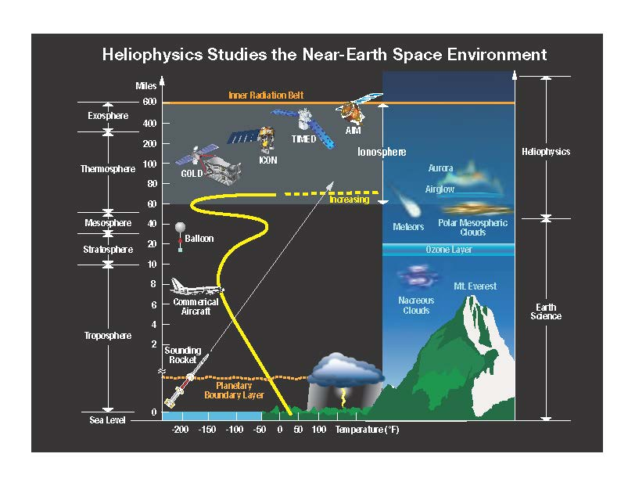
Magnetosphere = plasma above the atmosphere, within closed magnetic field, and the boundary/sheath
NASA
SAMPEX
NASA
Earth’s magnetosphere. See references below
website https://www.swpc.noaa.gov/phenomena/earths-magnetosphere
article https://link.springer.com/article/10.1007/s10712-018-9487-x

Slide 12
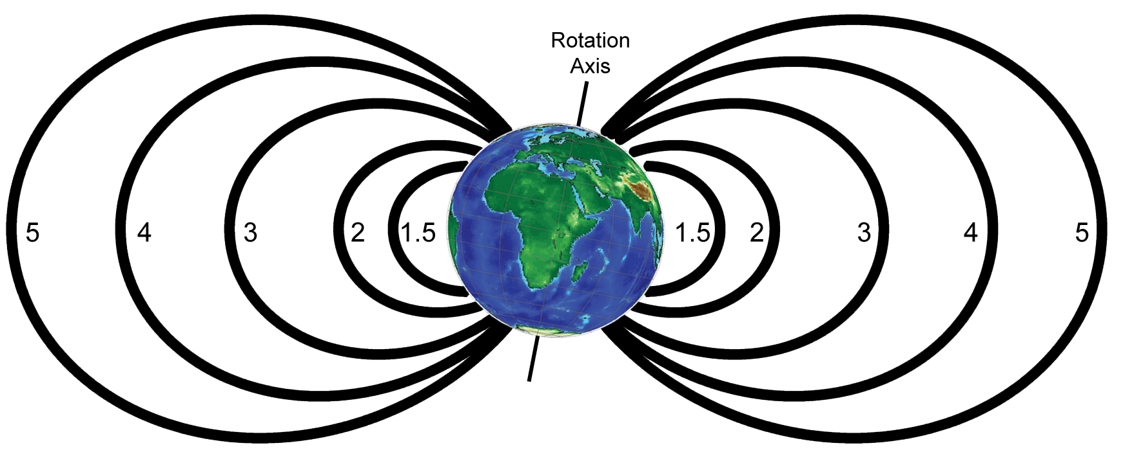
How do I know where I am in the magnetosphere?
Coordinates are L, MLT(Magnetic Local Time) and MLAT (Magnetic latitude)
Homework task 1
What is (geo-)magnetic local time (MLT)?
What is (geo-)magnetic latitude (MLAT)?
L-Shell
(number of Earth radii at geomagnetic equator)
[see reference 1]

Slide 13
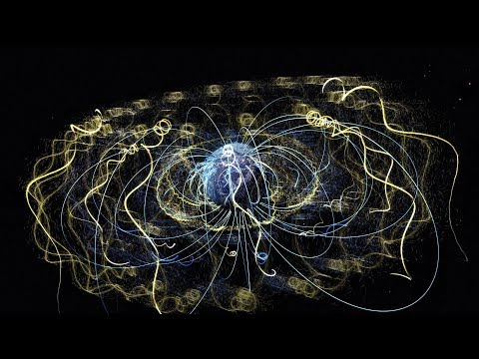
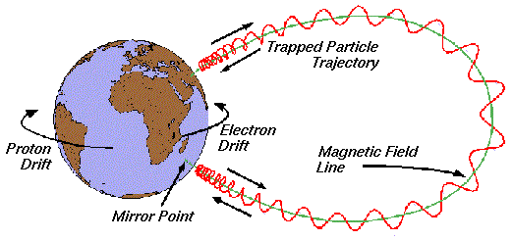
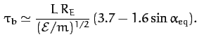
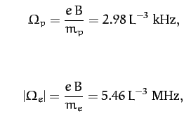
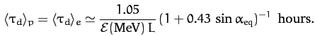
Why does plasma get trapped by the Earth’s magnetic field?
NASA
ESA/
SPENVIS
1. gyromotion
2. Bounce motion
3. Drift motion
Plasma physics in general [reference 1]
Radiation belts [references 1, 3, 4]

Slide 14
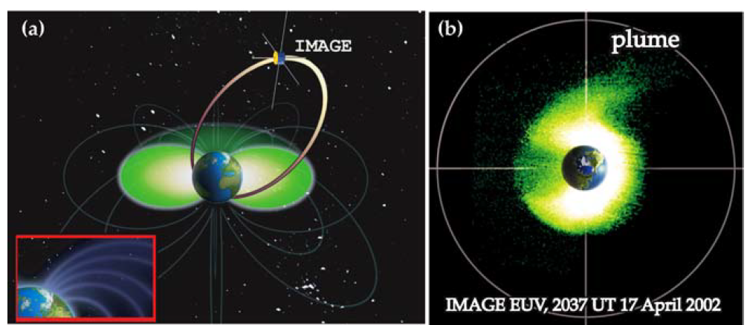
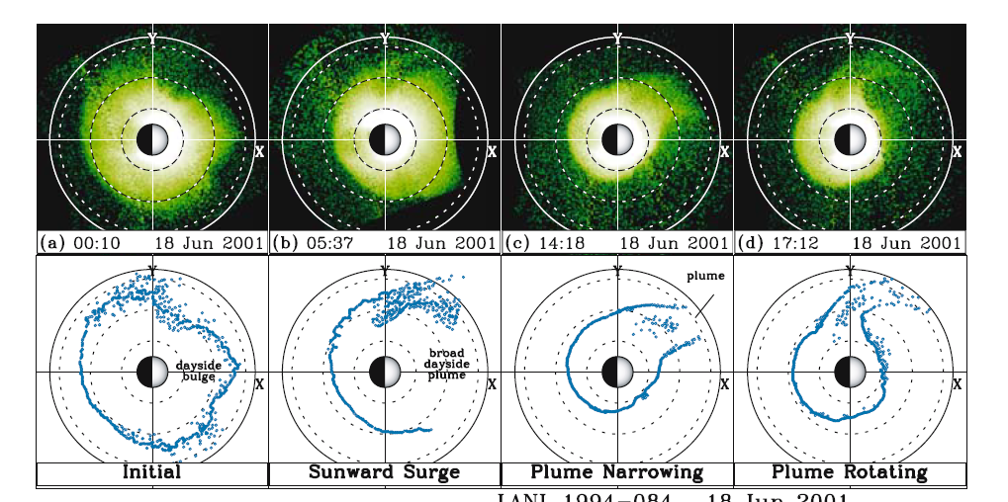
Plasmasphere is cold (Energy about 1eV) and dense
The boundary is the plasmapause.
Sometimes there is a plume
Plasmasphere
Plume
NASA
SAMPEX
Plasmasphere
“Cold” ~ 1eV
Dense ~ 10-10,000cm⁻³
80%H⁺ , 10-20%He⁺ & some O⁺
Co-rotating
Filled from ionosphere
Variable geometry r<2-6.6R_{E}
Plasmapause
Goldstein 2006 Sp.Sc.Rev.
https://link.springer.com/article/10.1007/s11214-006-9105-y

Slide 15
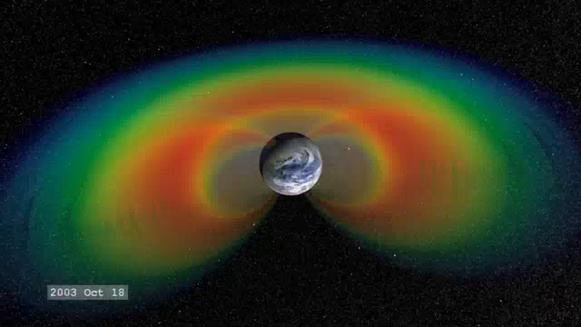
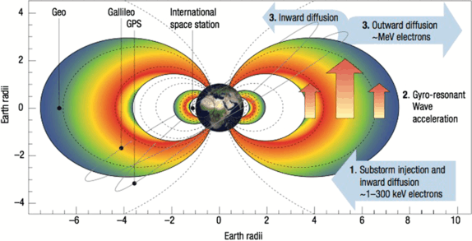
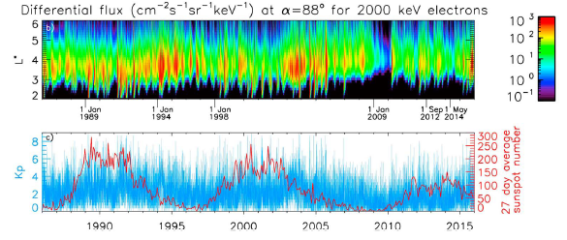
Earth’s dynamic radiation belts
12/21
NASA
SAMPEX
Horne 2007
Nature Physics
https://www.nature.com/articles/nphys703
Inner belt is energetic protons
Outer belt is energetic electrons
Glauert Horne Meredith 2018
Space Weather
https://agupubs.onlinelibrary.wiley.com/doi/full/10.1029/2018SW001981

Slide 16
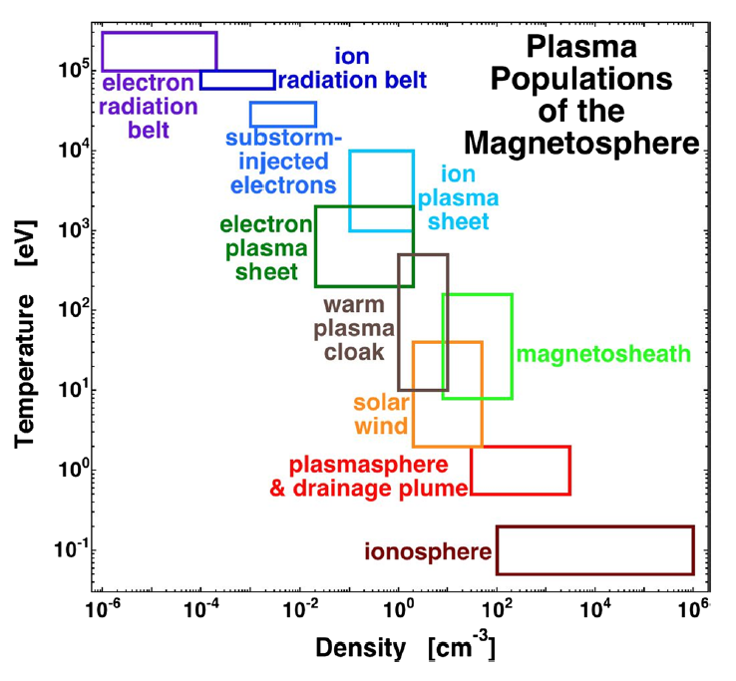
Radiation belts and plasmasphere overlap
Borovsky & Valdivia 2018 Surveys in Geophys.
https://msolss.github.io/MagSeminars/
https://link.springer.com/article/10.1007/s10712-018-9487-x

Slide 17
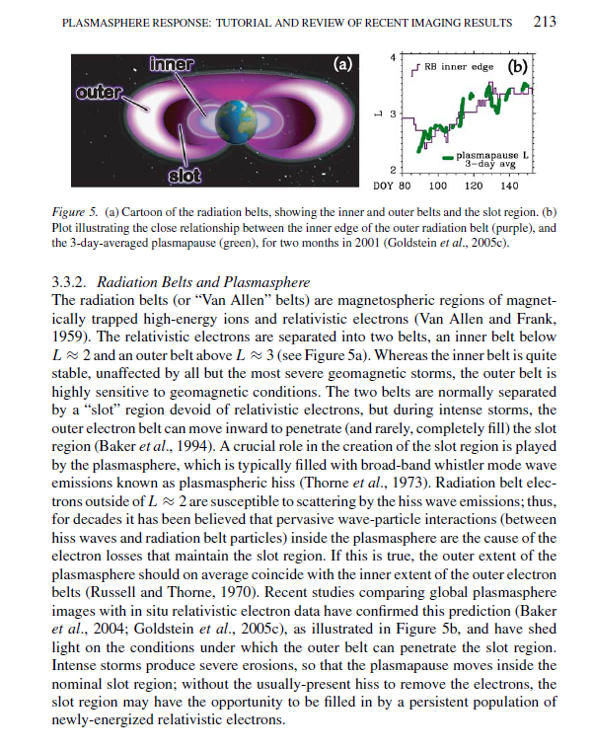
Why is it important to know about the plasmapause and plasmasphere?
Task 2
Read Goldstein 2006 paper (Section 1 and section 3)
Key facts
If we know where the plasmapause is, then we probably know where the inner edge of the outer radiation belt is (see Goldstein paper)
There are some important particle acceleration methods that only happen outside the plasmasphere. This is due to interactions with whistler mode chorus waves
(See reference [4] section 3.1)
Goldstein 2006 Sp.Sc.Rev.
https://link.springer.com/article/10.1007/s11214-006-9105-y

Slide 18
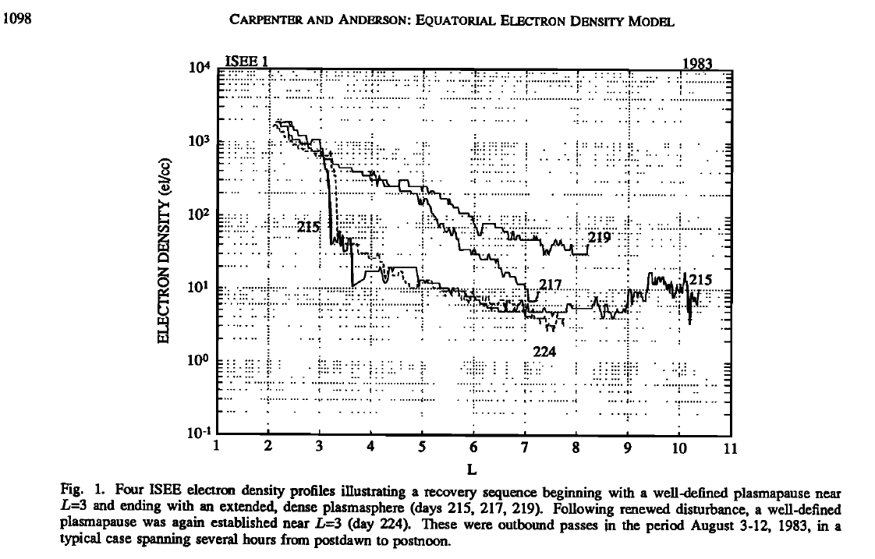
The Plasmapause is the outer boundary of the plasmasphere
Plasmapause is where the density drops.
Sometimes it drops very quickly,
and sometimes it drops slowly
It is not always easy to find it!
Carpenter & Andersen 1992 https://agupubs.onlinelibrary.wiley.com/doi/10.1029/91JA01548

Slide 19
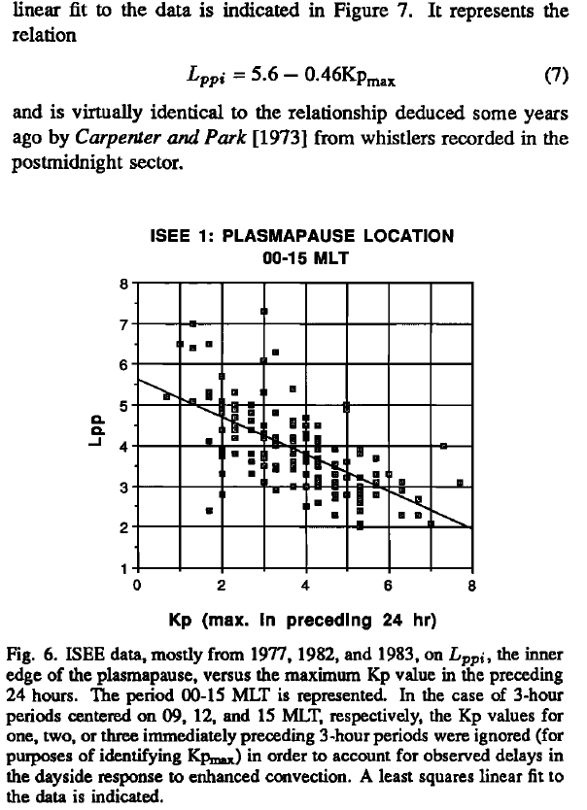
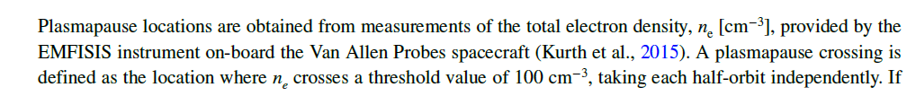
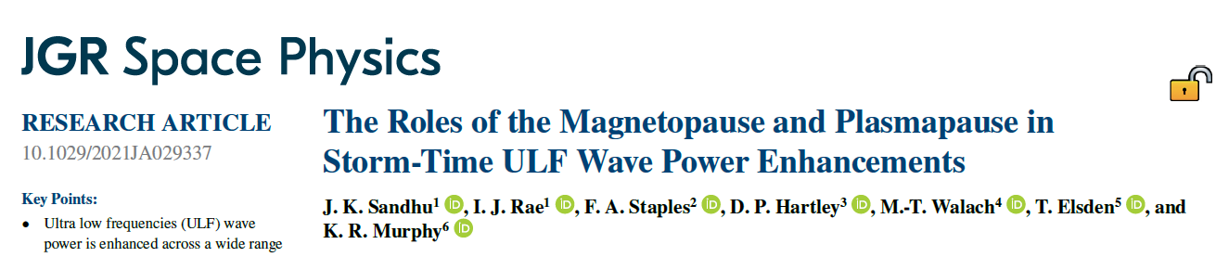
Two different models of the plasmapause location
1. Equation for plasmapause location (Lppi) that is a function of “Kp”
Kp is a geomagnetic index
High Kp means small Lppi
This equation is derived by fitting a line to data
“Empirical Model”
2. Apply a definition to the data
Measure number density of electrons n_{e}
If spacecraft measures…
n_{e} <100cm⁻³ then outside plasmasphere
n_{e}>100cm⁻³ then inside plasmasphere
Vs.
Carpenter & Andersen 1992
https://agupubs.onlinelibrary.wiley.com/doi/10.1029/91JA01548
Task 3
What is a geomagnetic index?
What is the Kp geomagnetic index and what does a value of Kp = … refer to? (Also known as the planetary K-index?)
Can you find any other geomagnetic indices that are used for space weather?

Slide 20
How do I know where I am in the magnetosphere?
Coordinates are L, MLT(Magnetic Local Time) and MLAT (Magnetic latitude)
Homework task 1
What is (geo-)magnetic local time (MLT)?
What is (geo-)magnetic latitude (MLAT)?
L-Shell
(number of Earth radii at geomagnetic equator)
[see reference 1]

Slide 21
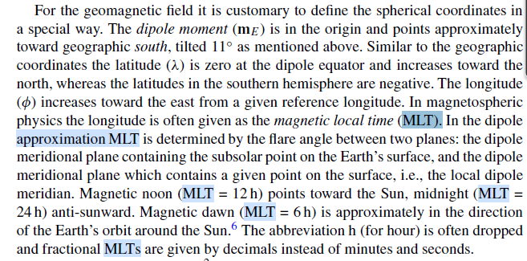
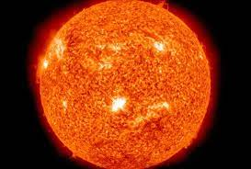
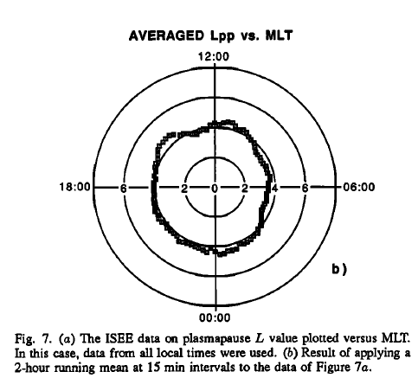
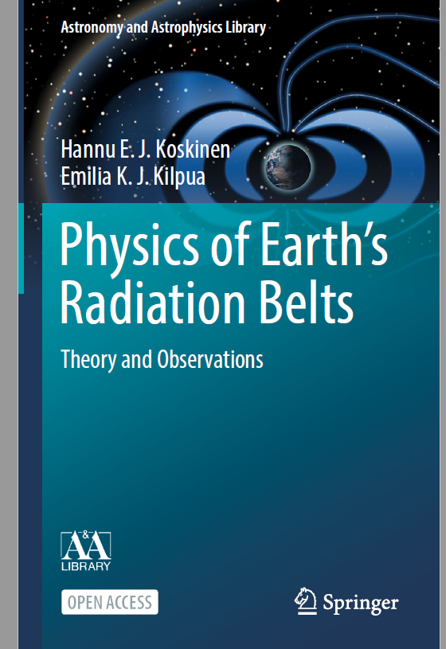
Task 1 MLT
Carpenter& Andersen 1992

Slide 22
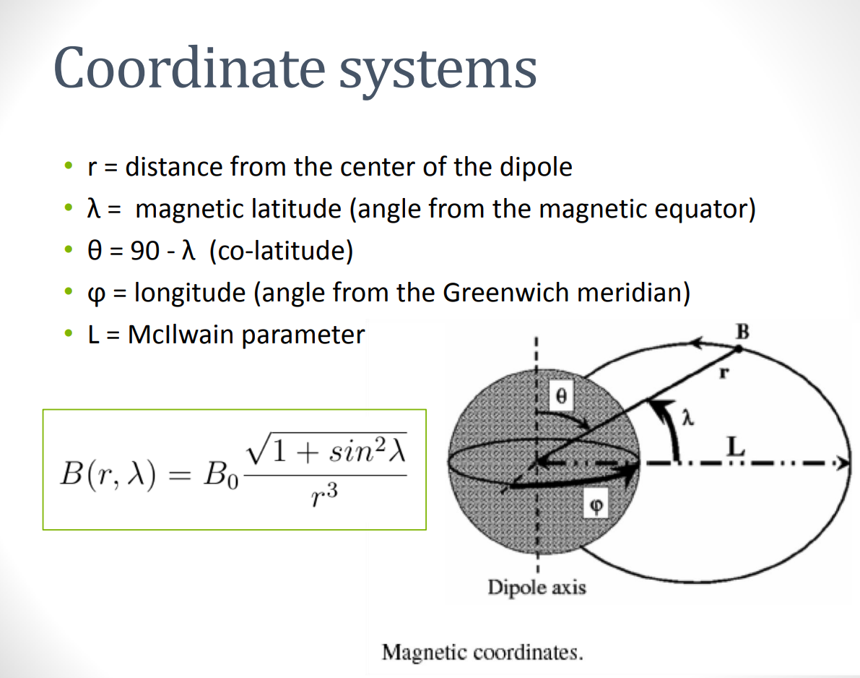
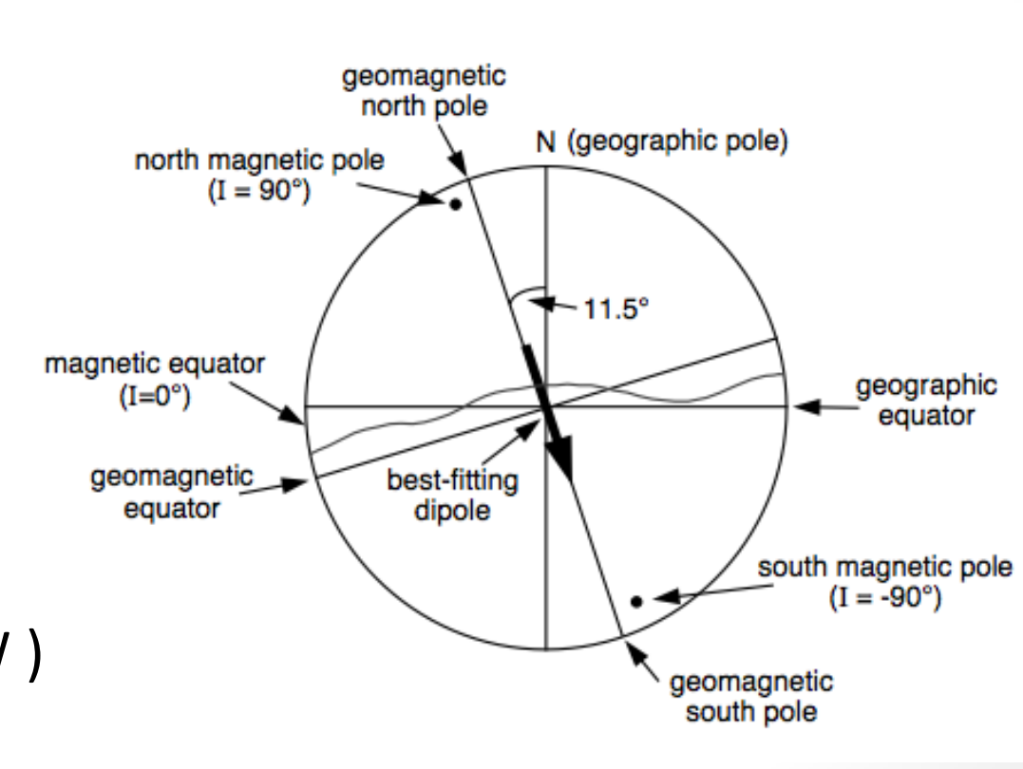
Task 1 MLAT
https://moodle2.units.it/pluginfile.php/125796/mod_resource/content/1/EarthMagneticField.pdf

Slide 23
Why is it important to know about the plasmapause and plasmasphere?
Task 2
Read Goldstein 2006 paper (Section 1 and section 3)
Key facts
If we know where the plasmapause is, then we probably know where the inner edge of the outer radiation belt is (see Goldstein paper)
There are some important particle acceleration methods that only happen outside the plasmasphere. This is due to interactions with whistler mode chorus waves
(See reference [4] section 3.1)
Goldstein 2006 Sp.Sc.Rev.
https://link.springer.com/article/10.1007/s11214-006-9105-y

Slide 24
Two different models of the plasmapause location
1. Equation for plasmapause location (Lppi) that is a function of “Kp”
Kp is a geomagnetic index
High Kp means small Lppi
This equation is derived by fitting a line to data
“Empirical Model”
2. Apply a definition to the data
Measure number density of electrons n_{e}
If spacecraft measures…
n_{e} <100cm⁻³ then outside plasmasphere
n_{e}>100cm⁻³ then inside plasmasphere
Vs.
Carpenter & Andersen 1992
https://agupubs.onlinelibrary.wiley.com/doi/10.1029/91JA01548
Task 3
What is a geomagnetic index?
What is the Kp geomagnetic index and what does a value of Kp = … refer to? (Also known as the planetary K-index?)
Can you find any other geomagnetic indices that are used for space weather?

Slide 25
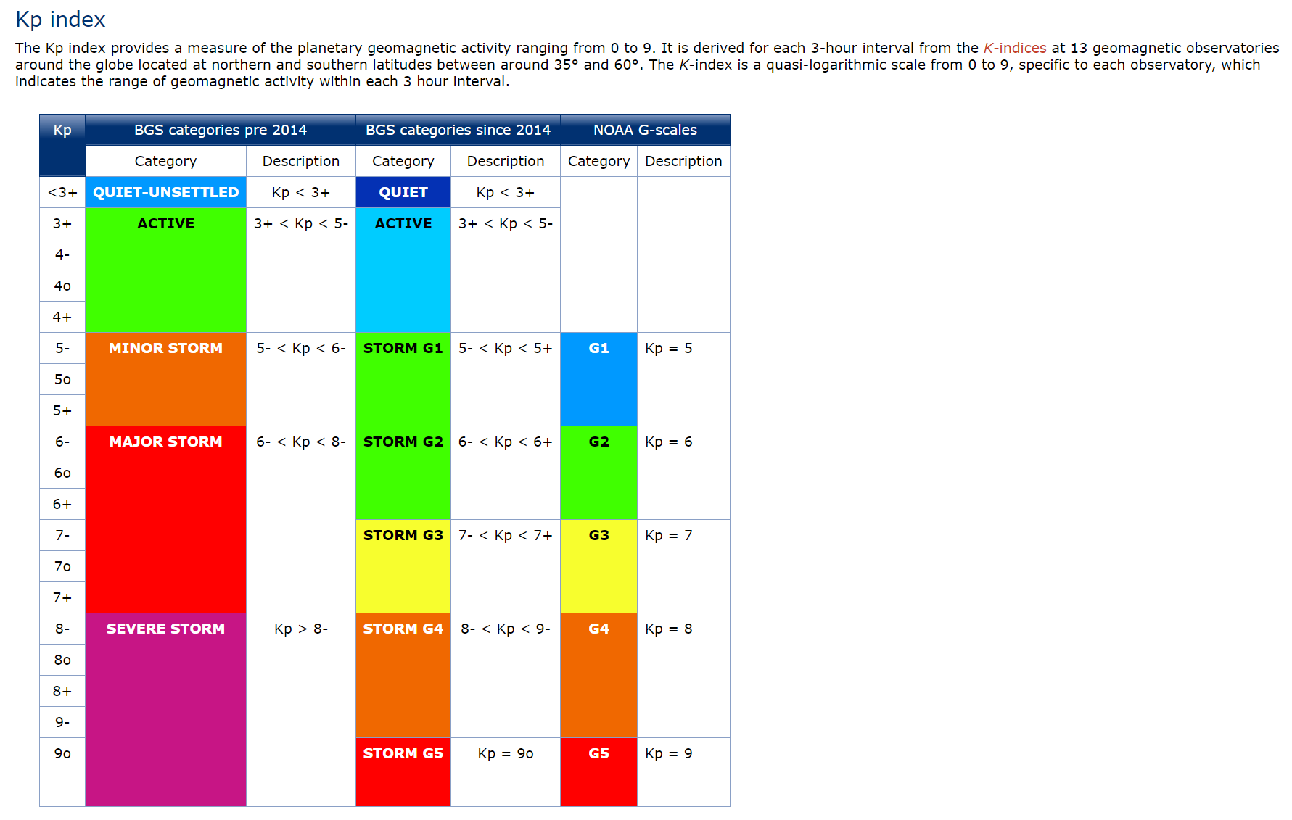
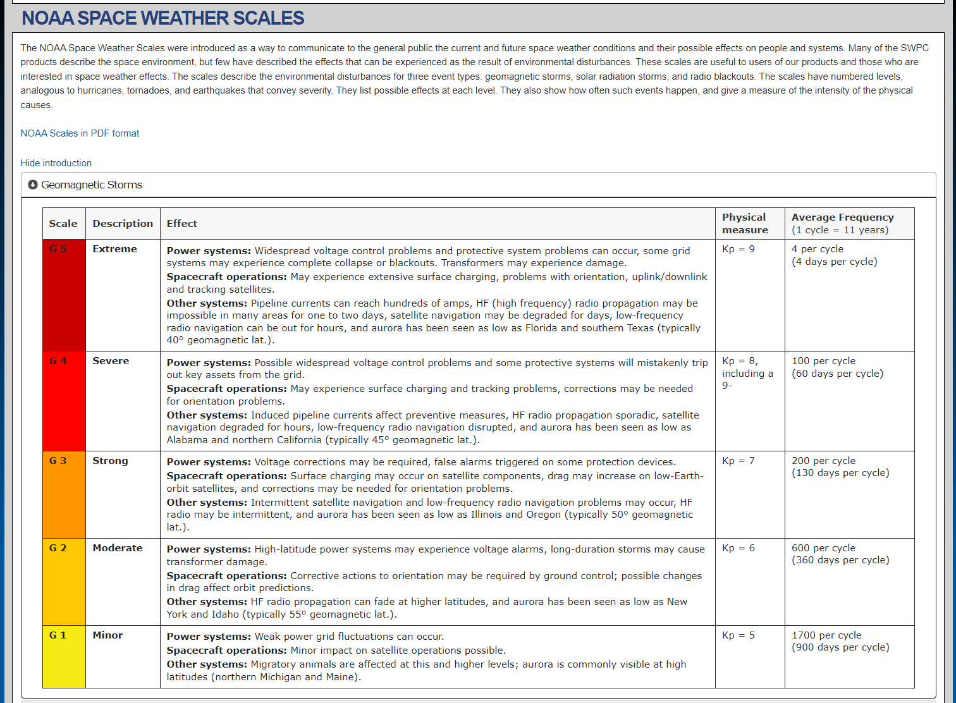
Task 3: Kp Index
Defined in this open access paper https://agupubs.onlinelibrary.wiley.com/doi/10.1029/2020SW002641
Can be downloaded from this website https://www.gfz-potsdam.de/en/section/geomagnetism/data-products-services/geomagnetic-kp-index and https://kp.gfz-potsdam.de/en/ and https://kp.gfz-potsdam.de/en/data
http://www.geomag.bgs.ac.uk/education/activitylevels.html
British Geological survey
https://www.swpc.noaa.gov/noaa-scales-explanation
NATIONAL OCEANIC AND ATMOSPHERIC ADMINISTRATION (USA)

Slide 26
Task 3: other indices
For information on other geomagnetic indices see e.g. https://www.ncei.noaa.gov/products/geomagnetic-indices
And https://www.ngdc.noaa.gov/stp/geomag/indices.html
It may be interesting and important to try and use some of these (or others!) in your project

Slide 27
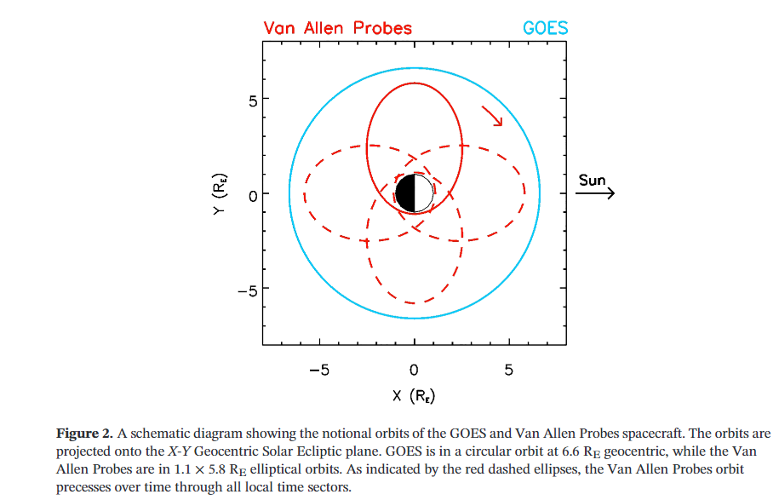
Orbit ~ 9 hrs
Precession of orbit ~ 1.5 years
https://agupubs.onlinelibrary.wiley.com/doi/epdf/10.1029/2019JA027331
Data overview
I will give you each approximately 1.5 years of number density and L, MLT, MLAT data
You will get the Kp data from online

Slide 28
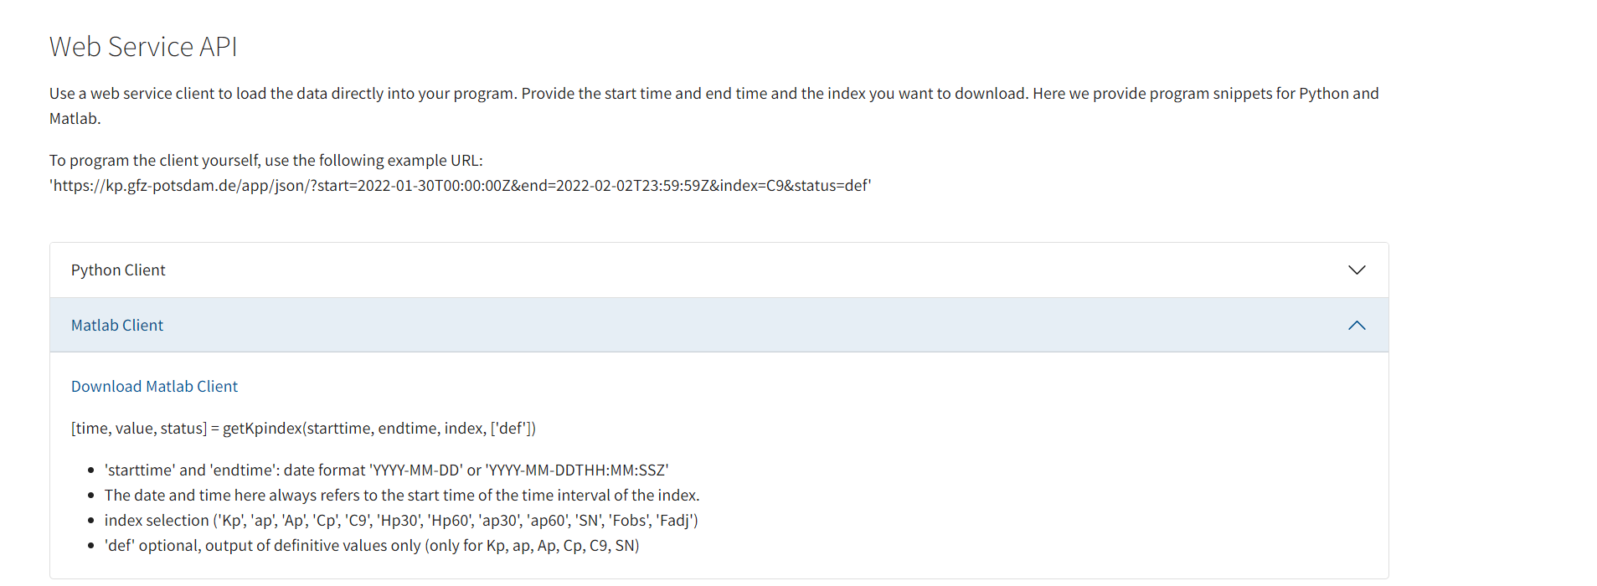
Kp Data:
Kp, from online
Every 3 hours
Data since 1932
0 -> 9 , in thirds
https://kp.gfz-potsdam.de/en/data
Download the Kp matlab client and put it in the folder with your code and data

Slide 29
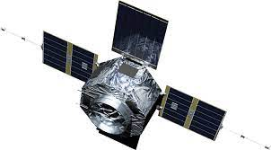
Number density Data:
Electron Number density – “cdf file”
These are in units of cm⁻³. Number of electrons per cubic centimetre
Data provided roughly every 6.5 seconds
Sometimes data will be missing! ☹
See https://uk.mathworks.com/help/matlab/common-data-format.html?s_tid=CRUX_topnav and
And https://uk.mathworks.com/help/matlab/examples.html?category=common-data-format&s_tid=CRUX_topnav
Measurement 2
(L₂, MLT₂, MLAT₂)
t₂
e.g. n = 110 cm⁻³
Measurement 1
(L₁, MLT₁, MLAT₁)
t₁
e.g. n = 96cm⁻³
Plasmapause somewhere in here!
e.g. estimate by interpolation
Location ~ 0.5((L₁+L₂), MLT₁+MLT₂, MLAT₁+MLAT₂) )
Time ~ 0.5 (t₁ + t₂)

Slide 30
Location Data:
L, MLT, MLAT
“h5 file”
This data is every 5 minutes
I will talk more about this in the future
See https://uk.mathworks.com/help/matlab/hdf5-files.html?s_tid=CRUX_lftnav and https://uk.mathworks.com/help/matlab/ref/h5read.html

Slide 31
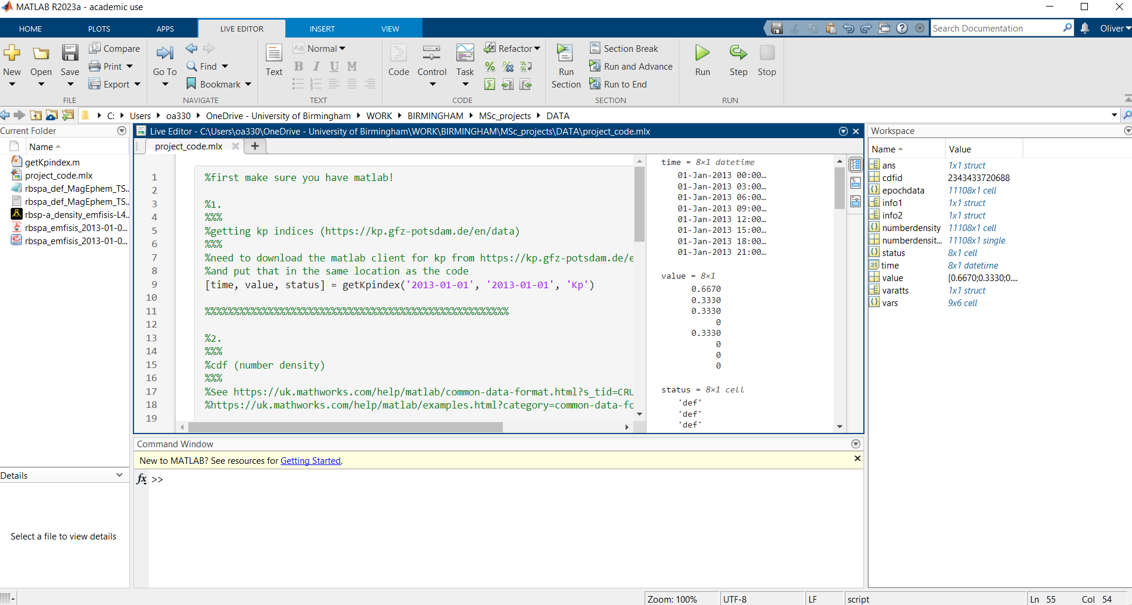
Code
I have sent you some example matlab commands to show you the basics of opening and reading the data
I will give more more guidance regarding the coding when we start the project work.

Slide 32
Access and open data
Goals:
1. Get Matlab
2. Get Kp tool from website and place it in same folder as your code and your data
Kp every 3 hours (0-3, 3-6, 6-9, 9-12,12-15, 15-18, 18-21,21-24)
Number density every 6.5 seconds
(L, MLT, MLAT) every 5 minutes
For every number density value you can
-assign the Kp for that 3 hour block
-interpolate the (L, MLT, MLAT) data to get the required value
-sometimes data will be bad or missing!
3. Build “DATASET 1” that gives you a value for each of the below quantities every 6.5 seconds
Time = ?
Kp = ?
Kp_{max} (maximum value of Kp in the previous 24 hours) = ?
n = ?
L = ?
MLT = ?
MLAT = ?
Analyse the Carpenter & Andersen Model
L_{ppi} = 5.6 – 0.46Kp_{max}
Goals:
4. Understand the Carpenter & Andersen model (equation 7)
This model gives plasmapause location Lppi as a function of Kpmax (the maximum value of Kp in the previous 24 hours)
Build a new model
Is it better than Carpenter and Andersen
L_{ppi} = ?
Goals:
8. This is where you need to add your own ideas!
A model might be an equation (or a collection of equations), or it might be a database.
Could you use machine learning?
E.g. see https://uk.mathworks.com/help/deeplearning/gs/fit-data-with-a-neural-network.html
5. Add the prediction of Carpenter and Andersen (L_{ppi} = ?) for every element in DATASET 1 to DATASET 1
6. Use the Sandhu et al 2021 criteria of
n<100 = outside plasmasphere
n>100 = inside plasmasphere
to check if Carpenter & Andersen is correct. This will be a “yes” (1) or “no” (0) for every point
7. How do these results (yes or no) change with respect to
(MLT, MLAT, Kp Kp_{max})?
Could you use more activity indices?
E.g. see https://www.ncei.noaa.gov/products/geomagnetic-indices
And https://www.ngdc.noaa.gov/stp/geomag/indices.html
Could you have different models for different values of Kp, MLT, MLAT etc?
Or something else?
How will you measure if your model is better than Carpenter and Andersen?
e.g. root mean square error?, or something else?
“Equation” model
Uses an equation (or more than one equation) to give L_{ppi} = ? As a function of different parameters
“Database” model
Uses e.g. machine learning or some other method to build a dataset that predicts L_{ppi} for given inputs
e.g. Carpenter and Andersen
e.g. see https://agupubs.onlinelibrary.wiley.com/doi/10.1002/2017JA024406
One Kp value (0-3hr)
Kp₁
(L₁ , MLT₁ , MLAT₁)
n₁
n₂
(L₂ , MLT₂ , MLAT₂) … etc
n_{3, etc}

Slide 33
Reminder
The aim of this project is to
try to build an improved model for the location of the Earth’s plasmapause,
and (most importantly!) to analyse if/when the model is better.
There are three main stages
Use the Sandhu et al method to check the spacecraft data and therefor analyse how good the Carpenter and Andersen model is
2. Try to build your own model that expands on the Carpenter and Andersen model
(e.g. using one or more of extra geomagnetic indices, machine learning, extra functional dependence on MLT)
3. Analyse whether or not your new model is an improvement on the Carpenter and Andersen Model. You will use the Sandhu et al method to check if each prediction is correct for each data point, and then use some statistical approaches to check if the model is better or not
(e.g. mean-square error, Receiver operating characteristic, etc)

Slide 34
1. Stage 1
Does this agree with Sandhu et al test?
Inside plasmasphere n>100cm⁻³
Outside plasmasphere n<100cm⁻³
Inside plasmasphere
L<L_{ppi}
What does Carpenter and Andersen predict for L_{ppi} for the relevant Kp_{max}?
Does this agree with Sandhu et al test?
Inside plasmasphere n>100cm⁻³
Outside plasmasphere n<100cm⁻³
Data in
n, L, MLT, MLAT, Kp
Outside plasmasphere
L>L_{ppi}
Make some analysis on the success/failure of Carpenter&Andersen and use this to inform your new model

Slide 35
2.Stage 2
Make a new model, using your analysis from stage 1 to inform you – see slide 41 for some ideas
3. Stage 3
Analyse whether or not this new model is better or worse than the Carpenter and Andersen model, and when
e.g. is it better/worse for some values of Kp? For some values of L, MLT, MLAT?
You may wish to use concepts such as root-mean-square error, but also others such as “ROC”
https://en.wikipedia.org/wiki/Receiver_operating_characteristic
See this paper for use of “ROC” in a space weather context
https://agupubs.onlinelibrary.wiley.com/doi/10.1029/2019SW002416

